Slide 1
DSC640 – Michael Ersevim
Assignment for weeks 3&4 – Airline safety

Slide 2
Airline Safety – Keeping perspective
Airline Safety – an internal memorandum and explanation
towards shaping the public’s perception
Michael Ersevim
I have created several dashboards to combat the current negative media coverage of airline safety. The messages of the dashboards regarding airline safety will have to be kept simple and direct and build a story. It is difficult to encapsulate in just one or two descriptive statistics the relative safety of airline travel without comparing its safety record to other, more common and ‘mundane’ methods of travel which few people give a second thought.

Slide 3
Airline Safety – Keeping perspective
The general public will only latch on to simple and clear statistics. However, the proper context for safety records comes with a little math. One needs to know the exposure – that is, the number of miles travelled to really appreciate how safe air travel is. Likening the chance of a fatality to another extremely unlikely event may also be another effective way to reach the public in order to convince them that air travel is the way to go.

Slide 4
Airline Safety – Keeping perspective
Clearly, the typical airline travel versus getting into a car have different purposes, distances, preparations and results. However, if one were to ignore the fact that driving (or taking a train or bus) to the same destination takes FAR longer, the danger of driving over flying is many multiples more dangerous.
The following dashboards are meant to get the public ‘on board’ and I will describe the reason why the choices and formats.

Slide 5
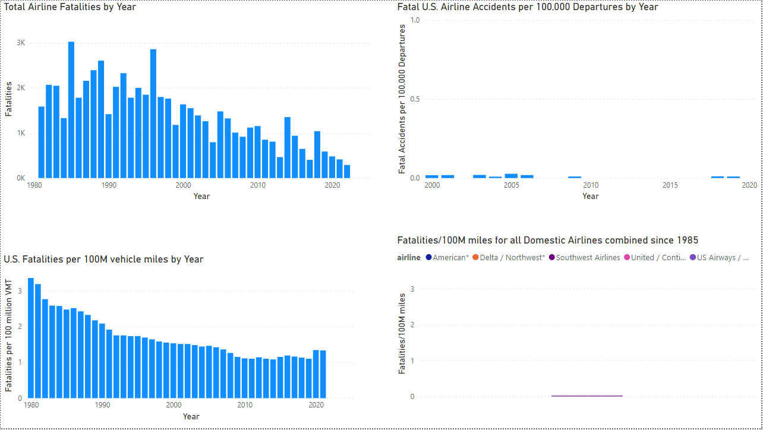

Slide 6
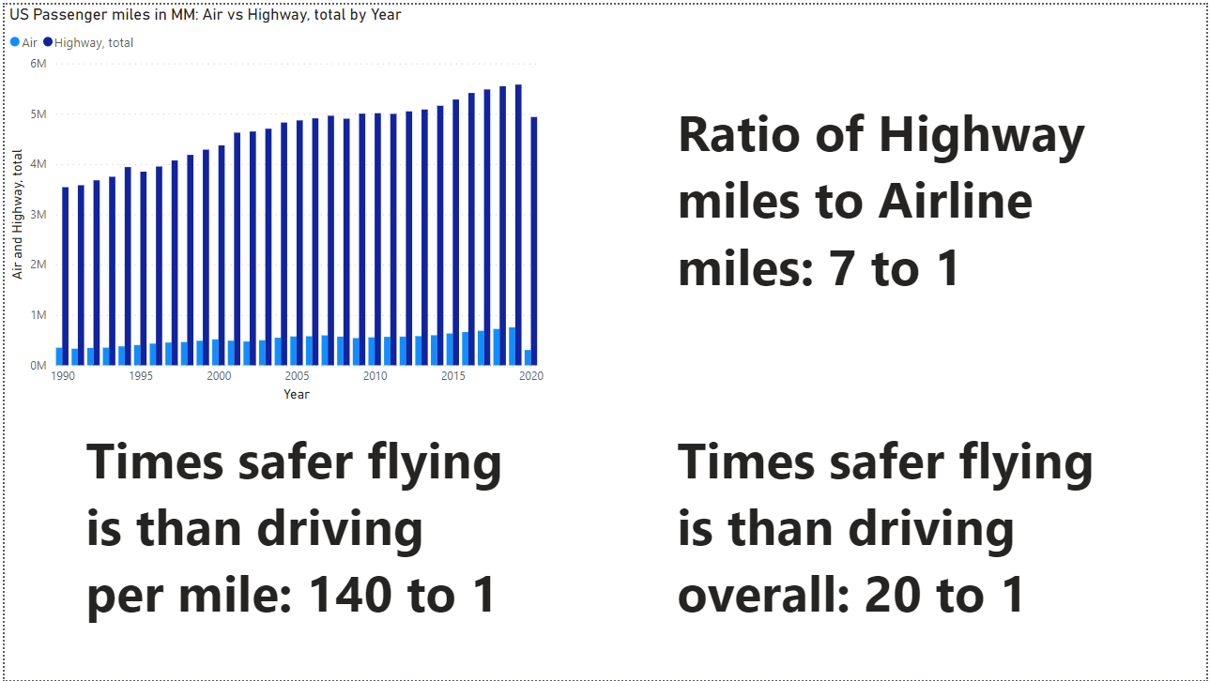

Slide 7
Airline Safety – Keeping perspective
First four graphs/dashboards to clearly show the narrative:
U.S. Total Airline fatalities. Shows the clear decrease over the last 40 years with absolute numbers per year for reference
U.S. Airline Fatalities / 100,000 departures. Y-axis is purposely ‘maxed’ at 1 to get a sense of the fraction of 1 chance in 100,000 departures for emphasis.
U.S. Auto Fatalities / 100,000 miles. Shows a decline as well, with absolute numbers against an exposure base that most have an intuitive feel for.
U.S. Airline Fatalities / 100,000 miles. Y-axis was set to the same as the prior dashboard to emphasize the miniscule ratio compared to auto fatalities per 100,000 miles.

Slide 8
Airline Safety – Keeping perspective
Last four graphs/dashboards to clearly show the narrative:
Total Auto passenger miles vs total US Airline miles per year. Shows that each is increasing over time,
A simple large font text box making explicit the relationship that airline mileage is about 1/7 of auto mileage.
A simple large font text box making explicit the relationship that airline fatalities per mile is about 1/140 of autos per mile.
A simple large font text box making explicit the adjusted relationship is the ratios of the two prior statistics reducing to the fact that airlines fatalities are approximately 20 times less likely per year, DESPITE driving 7 times more than flying

